Slide 1
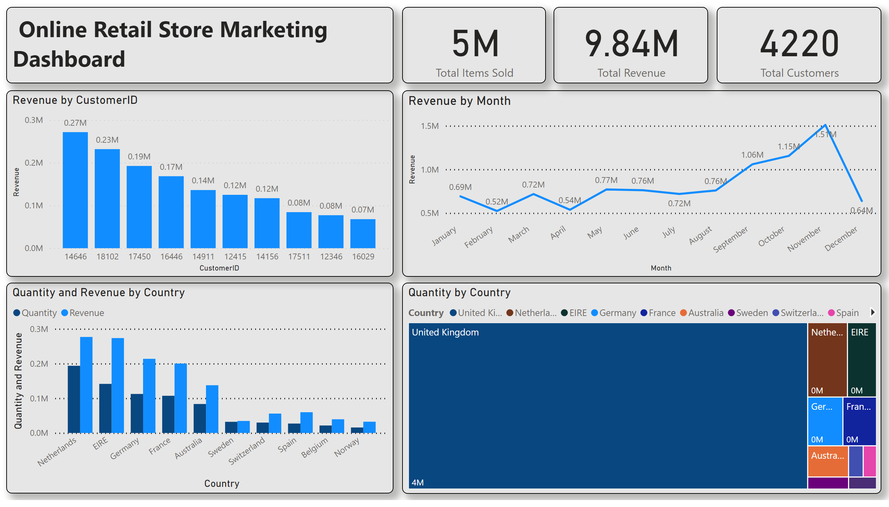
Page 1
Notes:
lineChart
No alt text provided
clusteredColumnChart
No alt text provided
clusteredColumnChart
No alt text provided
card
No alt text provided
card
No alt text provided
card
No alt text provided
textbox
No alt text provided
treemap
No alt text provided

